Slide 1
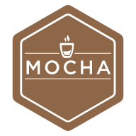

THE IMPORTANCE OF QUALITY ASSURANCE USING SELENIUM AND MOCHA JS
Date: April 20 2021
Name: Simon Parris
Title: The Importance of Quality Assurance Using Selenium and Mocha JS

Slide 2
Contents
AGILE DEVELOPMENT AND QUALITY ASSURANCE
Selenium
What is Selenium?
Pros and Cons of Using Selenium
Purpose and Importance in Process of Quality Assurance
Mocha JS
What is Mocha JS?
Pros and Cons of Using Mocha JS
Purpose and Importance in Process of Quality Assurance

Slide 3

Introduction
AGILE DEVELOPMENT
Agile software development refers to a group of software development methodologies based on iterative development, where requirements and solutions evolve through collaboration between self-organizing cross-functional teams.

Slide 4
Agile Development
The overall goal of each Agile method is to adapt to change and deliver working software as quickly as possible. However, each methodology has slight variations in the way it defines the phases of software development. Furthermore, even though the goal is the same, each team’s process flow may vary depending on the specific project or situation.
E.g
1st Event | 2nd Event | 3rd Event | 4th Event | 5th Event | 6th Event
Minimum Viable Product | Improvements and Features added to product. | The process is repeated and the end user is given an updated product. | Review by the end user is given until they are fully satisfied with the product. | Testing and Debugging phase. | Application Deployment and Maintenance
Given to End User to use. Input and feedback is relevant to the development process. | Multiple iterations can be made now we know our constraints. | Application development is repeated. | Development is complete. | Making sure quality meets budget requirements. | Application consistency target has been met.

Slide 5

Quality Assurance
Quality Assurance is a way of preventing mistakes and defects in manufacturing products.
The QA Process ensures the final product meets the company’s quality standards.
Quality Assurance ensures the requirements for the project is met before it is released.
To meet the assured quality of a specific product, numerous test need to be done to test the durability and functionality requirements of this product.
Failures to ensure this will allow defects to cause problems in the final release, reducing customer satisfaction and trust in the product.

Slide 6
Quality Assurance Requirements
Quality Assurance in the Agile Development life cycle requires cost effective and fast testing reporting times.
The objectives for an Agile life cycle constantly changes, so an adaptable testing framework is vital.
Testing frameworks will provide cost effective measures and reduce the overall production cost during the QA Process.
Automation and Test Reporting will be essential.
Quality Assurance relies heavily on consistency and repeatability.

Slide 7

Requirements for Testing Frameworks
The Testing Frameworks must be adaptable.
The testing frameworks in agile development must be able to automate tests quickly.
These Testing frameworks must provide cost effective measures, in terms of memory usage and data collection.
The testing framework must be easy-to-use.
The testing framework must be reliable and consistent.
Resources and Libraries will be essential.

Slide 8
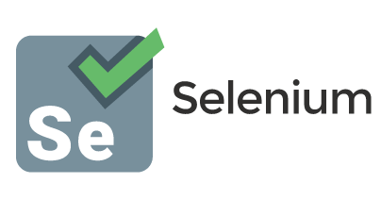
Selenium
Selenium is a portable framework for testing web applications.
Scripts written and recorded in Selenium may be recorded and edited manually providing autocompletion support and the ability to move commands around quickly.
Selenium is a Firefox plugin which allows testers to record their actions and then export them as a reusable script in one of many programming languages. Selenium’s recording feature, provides an easy-to-use interface for developing automated tests.

Slide 9

Selenium (Pros)
Selenium is easy to use
Selenium has the capability to convert tests written to different programming languages such as html, java etc.
Programming Language experience is not required.
Selenium IDE allows the user to debug and set breakpoints in their scripts. Hardware consumption by Selenium is also low when writing these scripts.
Selenium is flexible and can be easily integrated with JUnit and TestNG for generating reports and managing test cases.

Slide 10
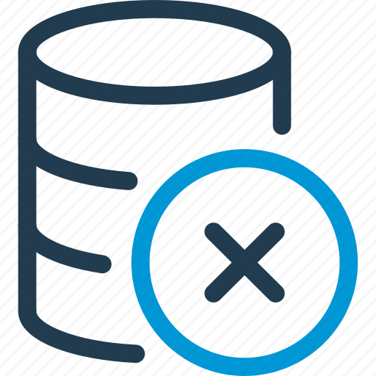
Selenium (Cons)
Unfortunately, Selenium IDE’s support is limited to Firefox
Selenium does not support iteration or conditional statements.
Selenium IDE does not support error handling.
Selenium does not support test script grouping of test methods.
Selenium doesn’t support database testing.

Slide 11

Benefits Selenium has for QA Processes
Automation Testing is wonderful.
Automation testing reduces waiting time for test results significantly.
Selenium testing provides repeatable testing. Repeatable testing is beneficial for achieving consistent test results.
Selenium testing is reusable. This reduces the production cost and memory use for repeating tests.
Automation Testing ensures consistency, improves product accuracy and saves the time and cost. More cycles of execution can be achieved through automation.
Automation Testing provides reliable development by employing scripts in testing. Scripts for the testing procedure increases reliability exponentially.

Slide 12
Mocha JS
Mocha JS is a Javascript test framework running on Node JS and in the web browser.
Mocha JS makes asynchronous testing simple (One phase at a time). Mocha tests run serially, allowing for flexible and accurate reporting while mapping uncaught exceptions to the correct test cases.
Mocha JS features browser support, asynchronous testing, test coverage reports and the use of any assertion library.
Mocha JS can be used with most Javascript libraries(should.js, express.js, chai.js, better-assert etc.).
Mocha JS provides an API which structures testing code into test case modules and test suites.

Slide 13

Mocha JS (Pros)
Mocha JS is a flexible testing framework. Mocha JS does not come with a mocking framework or assertion library. The choice of library is up to the user.
Mocha JS has widespread adoption. This means several add-on capabilities are available to this framework.
Mocha JS has an active community and users have the ability to find useful resources through libraries, blog posts, videos etc.

Slide 14

Mocha JS (Cons)
Mocha JS requires more configuration, making it a weaker framework.
If the tester cannot afford to be flexible, they will be forced to use an assertion library explicitly.
Mocha’s snapshot testing functionality is not easy to implement and will require additional libraries.

Slide 15
Benefits Mocha JS has for QA Processes
Mocha JS supports an assertion library. This allows the developers to check logic errors within their code. These exception handlers will be able to spot these errors so they can be fixed before the product is released.
Mocha JS also supports Test Driven Development so automated test cases will also work well with this software.
Early unit testing in Mocha JS will spot errors in code that will be hard to find later.
Early bug detection will reduce the number of issues with the product and will increase its quality at the time of release.

Slide 16
Conclusion
QA Process requires Speed and Consistency.
QA Processes in Agile require flexible and adaptable IDE’s
Selenium and Mocha JS Provide accessible and time efficient testing to web development.

